Slide 1
TS- WEB/CC/AI TRACK CAPSTONE PROJECT
Student Result Management System
Presented By:
1. Kareggari Veera Chaithanya - CSE(AI&ML)208R1A6627
2. Vanteddu Bhanupriya - CSE(AI&ML)208R1A6656
3. Vasre Shyamala - CSE(AI&ML)208R1A6657
4. Murarikar Bhagavathi - CSE(AI&ML)208R1A6686
Guided By: M.Vidya Sagar

Slide 2
OUTLINE
Abstract
Problem Statement
Aims , Objective & Proposed System/Solution
System Design
System Development Approach(Technology Used)
Algorithm & Deployment
Conclusion
References
Future Scope

Slide 3
Abstract
The Student Result Management System is a modern, web-based application designed to streamline the process of recording and managing student results. This system addresses the common challenges faced by educational institutions when managing academic records. It provides a user-friendly interface that allows administrators or teachers to input student names and marks in multiple subjects, including Telugu, Hindi, English, Maths, and Science.
The system's key feature is its ability to calculate and display the total marks for each student, simplifying the grading process. Furthermore, the results are presented in a structured table format, making it easy to view and analyze student performance. This project aims to revolutionize result management by automating the process, reducing the potential for human error, and ensuring accurate and organized record-keeping.

Slide 4
Problem Statement
Traditionally, educational institutions have relied on manual methods for recording and managing student results. These methods often involve handwritten records, spreadsheets, or desktop applications. This manual approach is not only time-consuming but also prone to errors, which can lead to inaccuracies in academic records. Educational institutions face challenges in terms of data organization, retrieval, and analysis. The need for an efficient, digital solution to address these issues has become apparent.

Slide 5
Proposed Solution
The system is a user-friendly Student Result Management System that streamlines the process of recording and managing student results, including names and marks in Telugu, Hindi, English, Maths, and Science subjects.
A standout feature is automatic total marks calculation for each student, removing manual work. Results are neatly presented in an easily understandable table format.
The solution utilizes JavaScript for interactivity, CSS for styling, and HTML for structure. JavaScript handles data storage with Local Storage, while CSS ensures a visually appealing layout. In practice, this can be adapted to work with a server-based database for more robust data management.

Slide 6
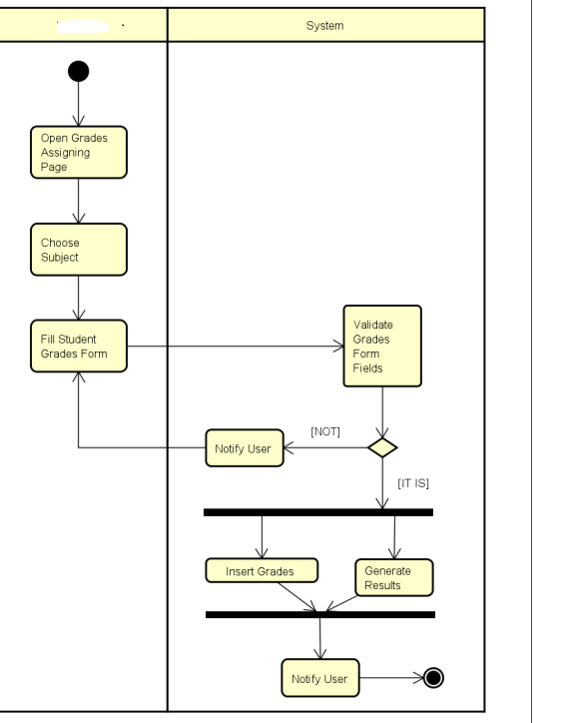
System Architecture
Student

Slide 7
System Deployment Approach
-Frontend: HTML, CSS, JavaScript
- HTML provides the structural framework for the web application.
- CSS enhances the user interface by providing styling and layout design.
- JavaScript facilitates interactivity, data processing, and storage.
-Storage: Local Storage (for demonstration purposes)
- Local Storage is used as a temporary data storage solution for this project.
- In practice, a server-based database would be used for more robust data management.

Slide 8
Algorithm & Deployment
The Student Result Management System follows a straightforward algorithmic process:
The system collects student names and subject marks using HTML input fields.
JavaScript code retrieves and stores data in Local Storage, allowing for persistent storage.
The system calculates the total marks and dynamically displays results in an HTML table.
Deployment involves hosting the HTML, CSS, and JavaScript files on a web server for access by users.

Slide 9
Conclusion
In conclusion, the Student Result Management System offers a practical solution to the challenges faced by educational institutions in managing student results. By automating the process and providing a digital platform for data storage, this system significantly reduces the risk of errors associated with manual methods. While the current implementation uses Local Storage for data storage, future iterations can seamlessly integrate with server-based databases for scalability and advanced features.

Slide 10
References
This standalone project does not require external references as it is a self-contained system developed for demonstration purposes.

Slide 11
Future Scope
The Student Result Management System has the potential for further enhancement and expansion:
User Authentication: Implement user authentication for secure access, ensuring that only authorized personnel can input or access student data.
Admin Privileges: Introduce admin privileges for managing and editing results, providing administrative control over the system.
Subject Expansion: Extend the system to support a broader range of subjects, accommodating diverse educational institutions.
Server-Based Database: Transition to a server-based database for enhanced data management, scalability, and reliability.
Report Generation: Implement report generation capabilities, allowing users to generate and export comprehensive reports based on stored data.

Slide 12
THANK YOU

